Slide 1
Chapter 6 Section 1C
Solving 1-step Inequalities

Slide 2
Inequality symbols
Used to compare 2 non-equal values
Symbol Read as
< “ is less than”
> “ is greater than”
≤ “ is less than or equal to”
≥ “ is greater than or equal to”

Slide 3
Solving Inequalities
Steps for solving:
  Perform opposite information to solve for the variable
  If you multiply or divide by a negative number, you must FLIP the inequality sign
  Graph the solution on a number line

Slide 4
Examples:
1.
2.

Slide 5
Examples:
3.
4.

Slide 6
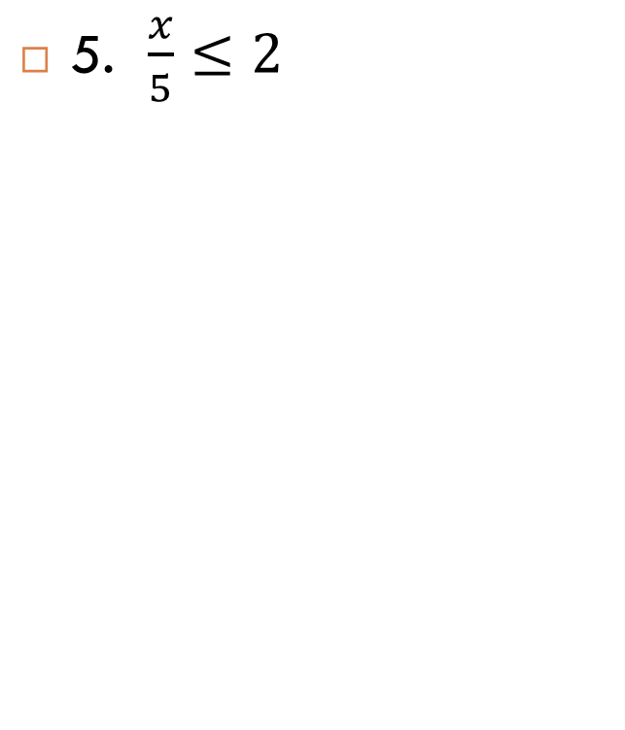

Examples

Slide 7


Examples

Slide 8
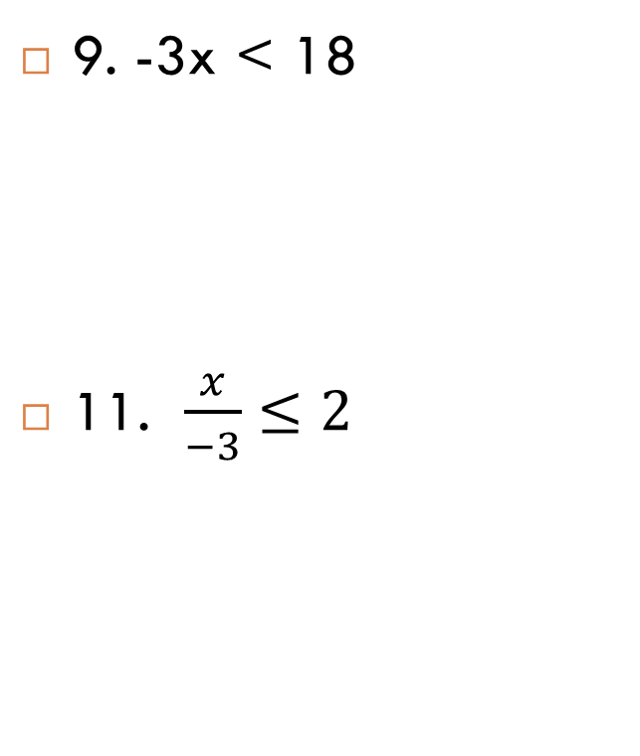
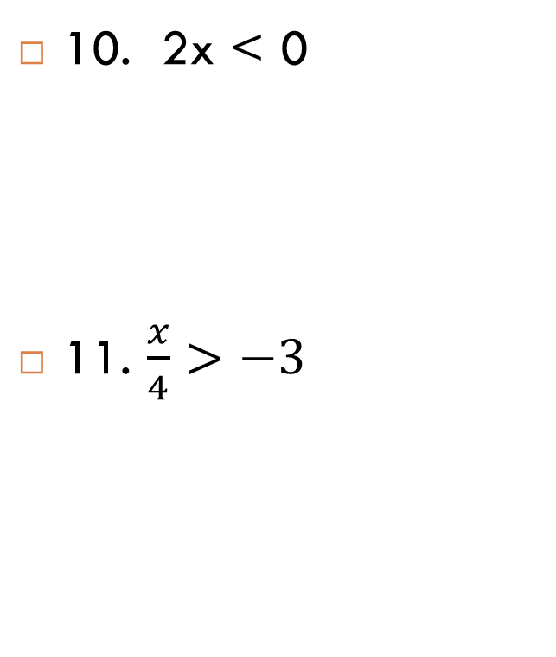
On your own

Slide 9
Classwork
Blue book Page 173 # 1-16

